Slide 1
Multiple Linear Regression in Practice: Predictors, Hyperplanes, and the Advertising Example
Chapter 9
Built from current MLR conceptual practice slides 73-79

Slide 2
Multiple Linear Regression
Simple Linear Regression (SLR)
$$Y=Xβ+ε$$
Multiple Linear Regression (MLR)
$$Y=Xβ+ε$$
For our assumptions on $ε$.
Where $X$ is the design matrix and $β$ is the vector of coefficients.

Slide 3
What is Different?
In Multiple Linear Regression, we can have multiple predictors.
Tradeoff:
Graphics are difficult in higher dimensions.
Least squares fit is now a (hyper) plane instead of a line.

Slide 4
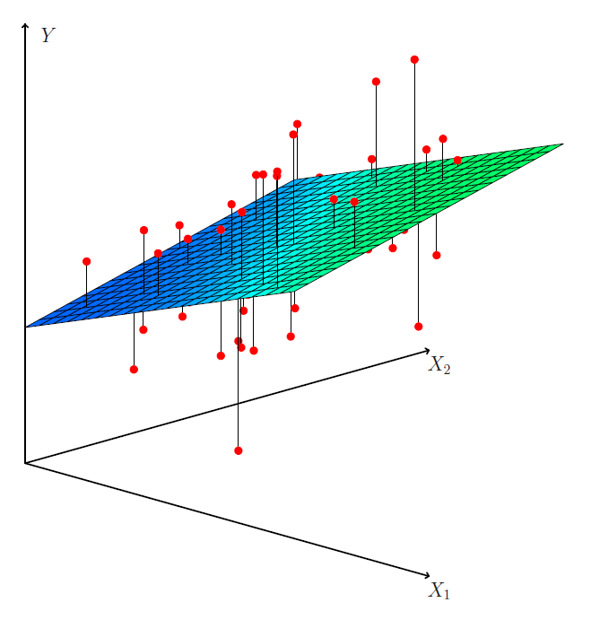
What is Different?
Least squares fit is now a (hyper) plane instead of a line.
Source: ISLP Figure 3.4

Slide 5
Let’s Look at a Dataset
Advertising.csv
Contains data on
(Selected) Response Variable: Sales thousands of units
Predictors are advertising budgets: TV thousands of dollars Radio thousands of dollars Nespaper thousands of dollars
200 different markets.

Slide 6
Some Important Questions
Is at least one of the predictors (TV, Radio, Newspaper) useful in predicting the response (Sales)?
Do all of the predictors help to explain Sales, or is only a subset of predictors useful?
How well does the model fit the data?
Given a set of predictor values, what response value should we predict for Sales, and how accurate is our prediction?

Slide 7
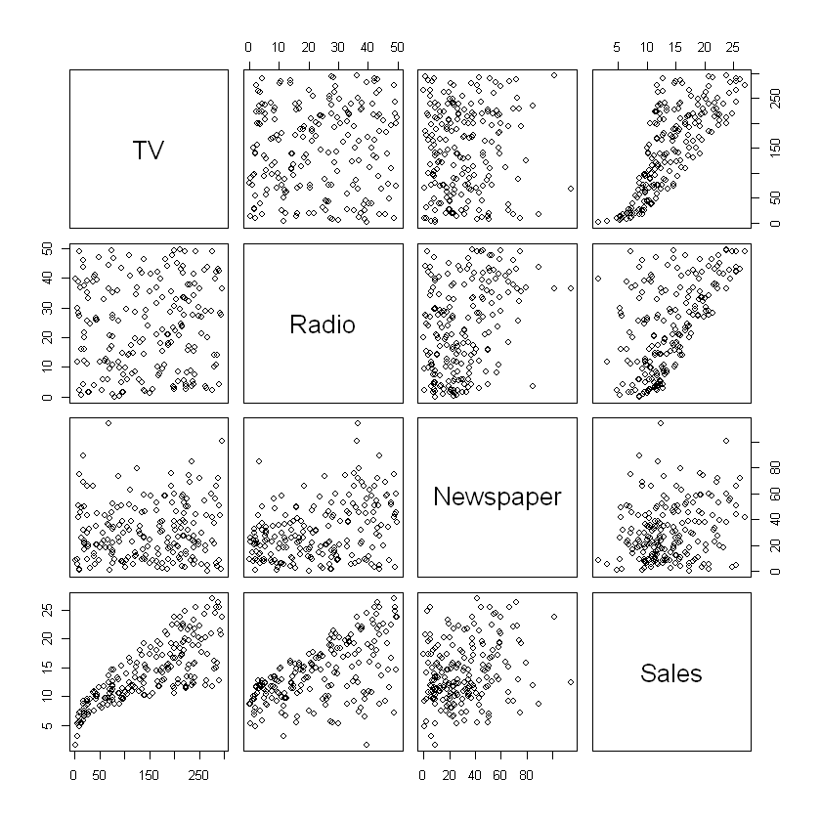
Scatterplot Matrix

Slide 8
Things to Note
Which predictors have the strongest correlation with Sales?
Which predictors have the strongest correlation with each other?

